Slide 1
Z-Goggles
Multi-function Vision System
Group 1
C.J. Silver
Geoff Jean
Will Petty
Cody Baxley

Slide 2
What are Z-Goggles?
Vision Enhancement System
3 cameras – Visible, IR, UV
Image change functions – Shift, Drunken Vision, Photo-negative, Spectrum Shift
Function control via UI controller
Portable, helmet-mounted screen
Battery-powered

Slide 3
Goals and Objectives
Cost-effective engineering
    Low cost components requiring more work
Portability
    Battery and backpack/helmet system allows movement
Simple to use
    Simple UI controller for video mode and functions
Effective video processing and display
    Minimize choppiness by maximizing processing speed via parallel logic implementation

Slide 4
Design Approach
Separate systems – Integrated at later stages
Optical System
Video Processor
Display
User Interface
Power supply
Processor
Optics
Display
User
Interface

Slide 5
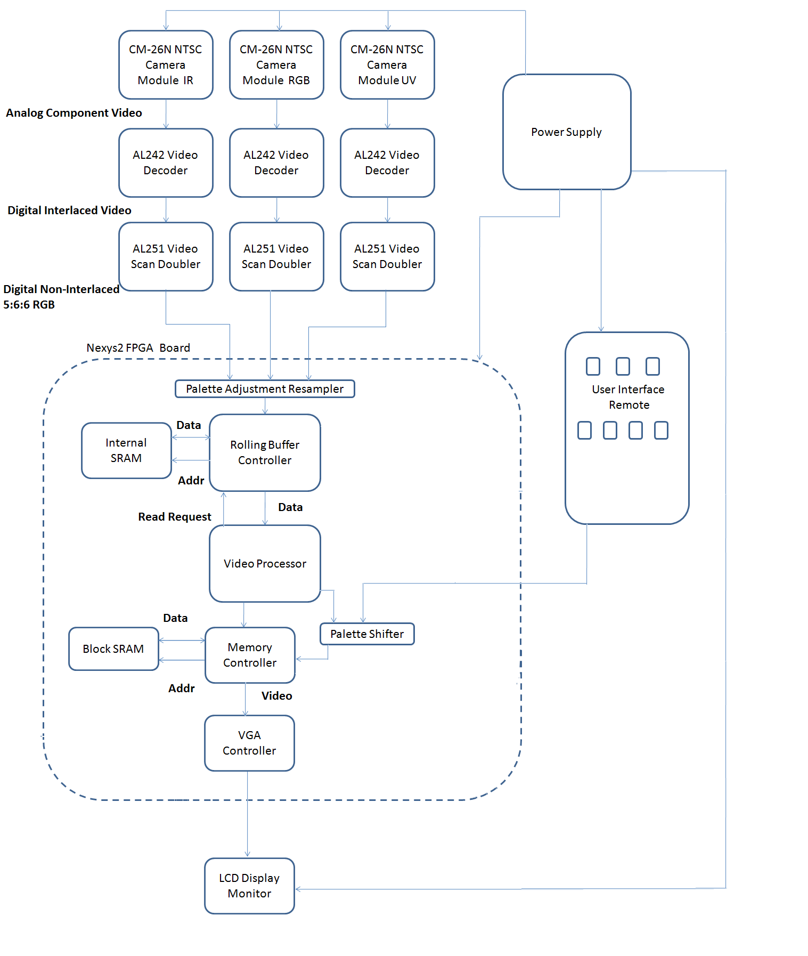
Overall
Project
Diagram

Slide 6
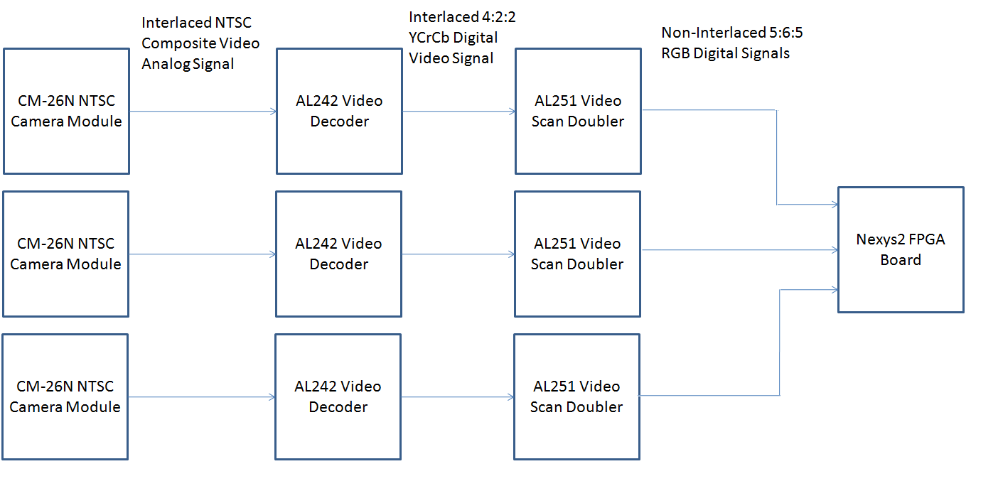
Optical System overview

Slide 7
Optical System Specs and Reqs
The unit shall contain three cameras to capture live video data.
One camera will be filtered normally to allow color video. One camera will be filtered with a UV pass filter to allow UV video. The final camera will be filtered with an IR pass filter to allow IR video.
Cameras resolution will be at least 320 x 240, up to 640 x 480.
The Optical System will output RGB or YUV data in a usable or convertible size (8bit is the target for the Video Processor).
The system shall be capable of achieving at least 15 fps (30 preferred).

Slide 8
Design Decision– Webcam issue
Initial design concept used Logitech C200 webcam for cameras
Discussion with Logitech technical support revealed necessity to create a dummy Windows driver to run cameras
Reverse engineering the driver to decode the USB information was deemed too time intensive – thus the move to the CM-26N

Slide 9
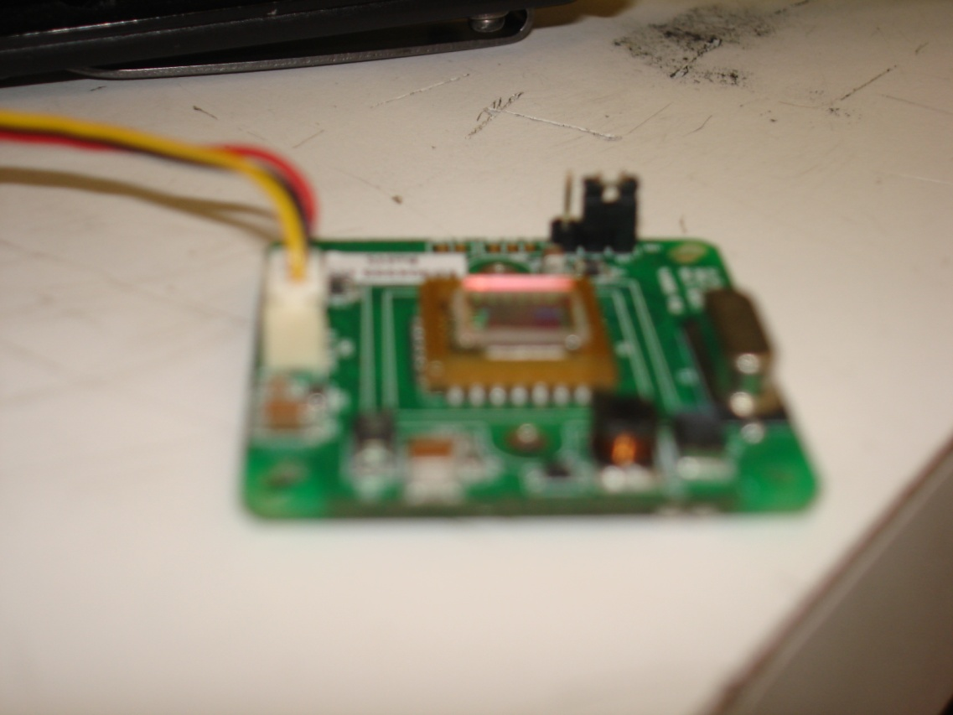
Checking IR filter
Opened camera and determined an IR filter was present
Filter will be removed and replaced with Wood’s Glass for the UV cam, and photo negative film for the IR camera.

Slide 10
Difficulty – NTSC camera not working
No image found within the output, though color changes slightly when objects are moved into view.
Camera is experiencing sync signal issues.
Connections are properly grounded and powered.
Tested on multiple televisions, old and new.

Slide 11
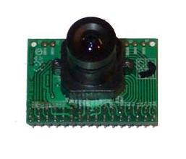
Design decision – Camera Replacement
Due to issues, decided to check other cameras.
Found a digital output camera that has the specifications we need, the C3188A, based on OV7620 sensor from OmniVision.
16/8 bit output RGB or YUV, or monochrome composite for testing.
Programmable through I2C interface.

Slide 12
Video Processor overview
IR
UV
RGB
Grayscale
Buffer
Controller
Merge
UI
Blur
Edge Detect
Palette Shifter
VGA
Output

Slide 13
Design decision – Platform (DSP vs. FPGA)
FPGA
  Scattered support of operations
  Time-consuming implementation
  Timing guarantees
  Cheap development environments
DSP
  Strong compiler and toolchain support
  Fast linear multiply/add
  Greatly simplify implementations of 2d transforms
  No guarantee of timing/throughput

Slide 14
Design decision – Which FPGA used, why?
S3BOARD
  1Mb onboard asynchronous SRAM 10ns access time
  500MHz max internal clock speed
  Too few GPIO pins for 16-bit inputs
Nexys2
  8bpp Video
  Lots of GPIO pins
  Higher gate count

Slide 15
Video Processor Specs and Reqs
640x480 30fps 8/16bpp
Pixel process time: 108ns
Multiply/Add time <20ns
Buffer Read at least 3x faster than pixel clock
FIFO based system
Dual-buffer cache system
  3 video lines of storage for transforms
  3x3 storage element to reduce memory load

Slide 16
Success – Subsystem Construction
Optimization of edge detection with Sobel Operator
Optimization and proof for integer blur
Buffer controller design
Video output controller

Slide 17
Design – Edge Detection/Blur
A | B | C
D |  | E
F | G | H
-1 | 0 | 1
-2 | 0 | 2
-1 | 0 | 1
-1 | -2 | -1
0 | 0 | 0
1 | 2 | 1
Gx=(H-A)+(F-C)+(G-B)<<1
Gy=(H-A)+(C-F)+(E-D)<<1
G=|Gx|+|Gy|
X | X | X
X | Y | X
X | X | X
(2^Z)(2^(X+3)+2^Y)=1
-4 | -1 | 0
-3 | 0 | -1
-2 | 1 | -2
-1 | 2 | -3
0 | 3 | -4

Slide 18
Difficulty – Possible Timing problems
Synchronization of video frames
Merge latency
Data sampling
I2C control translation between UI and camera

Slide 19
Display Specs and Reqs
The unit’s display system shall be capable of displaying at least 15 fps (30 preferred).
The unit’s display system shall be VGA compatible for easy interfacing.
The unit’s display system shall be mounted approx 6” from the user’s face, and enclosed in a manner that allows the user to focus on the screen.
The unit’s display system will be capable of outputting a resolution of 640x480.
The unit’s display system shall receive valid frame data via a VGA controller on a FPGA board.

Slide 20
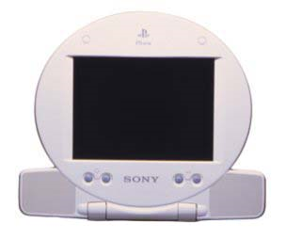
Design decision – PSone screen vs. others
LCD Screen | Resolution | Connection | Price
Crystalfontz CFAF320240F-T | 320x240 | QVGA | $51.16
Sharp Microelectronics LS037V7Dw01 | 640x480 | VGA/QVGA | $150+
SCPH-131 Sony Playstation | 640x480 | AV in | $55

Slide 21
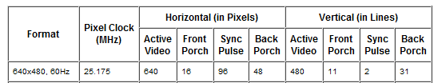
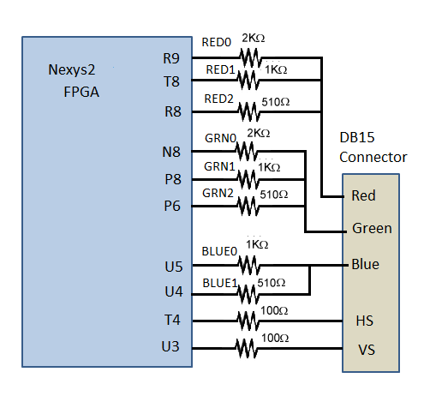
VGA Interface
Software: VGA Controller:
Signal Timing:
Output Signals:

Slide 22
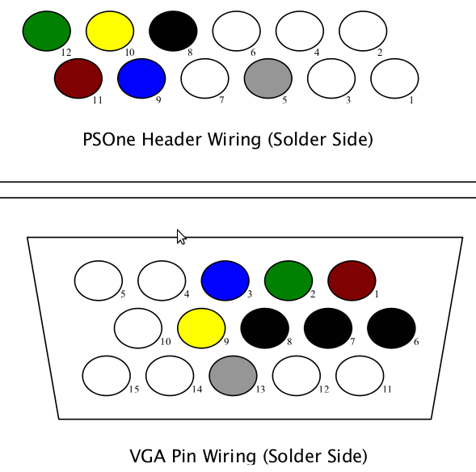
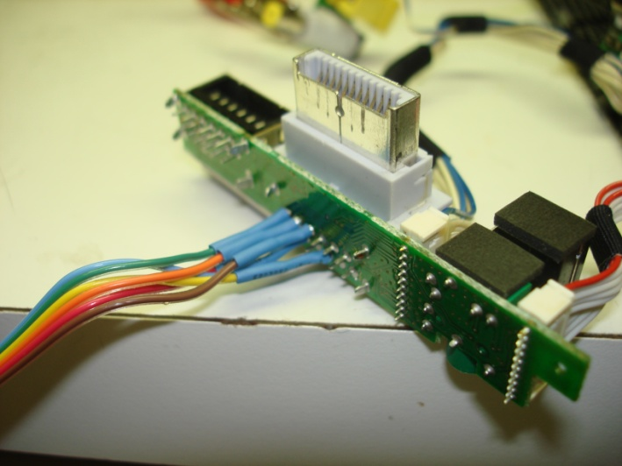
VGA Interface
Sony LCD screen needs to be modified to support VGA connection
Pin layout of VGA connector
PIN | PIN Signal
1 | RED Red video
2 | GREEN Green video
3 | BLUE Blue video
5 | GND Signal ground
6 | RED_RTN Red ground
7 | GREEN_RTN Green ground
8 | BLUE_RTN Blue ground
9 | VDC 5 VDC supply (fused)
13 | HSYNC Horizontal sync
Solder points from VGA connection

Slide 23
Display work for prototype
Programmed an 8-bit VGA controller in Verilog
Soldered the connecting wires of the VGA output cord to the correct pins on the screen
Assembled working VGA connection cord with ribbon wire and the correct DB-15 connector
Tested the output of screen with VGA controller on FPGA

Slide 24
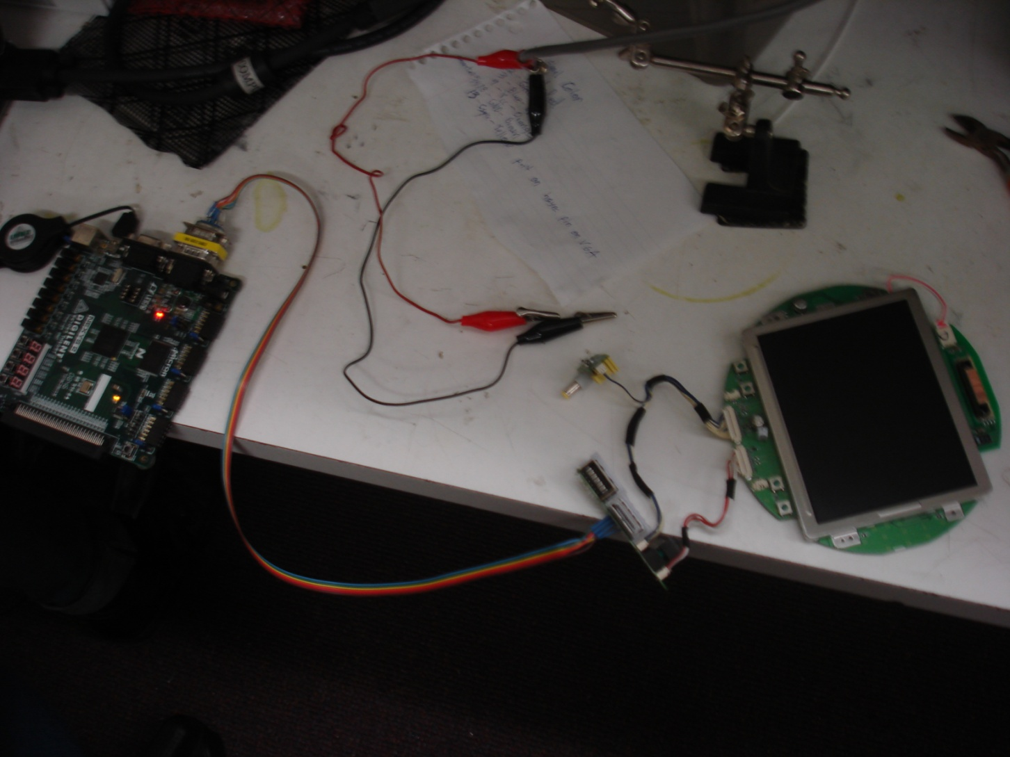
Display System Prototype

Slide 25
Display Screen Difficulties
Composite Sync Pulse timing problems
-Not a XOR of Vertical and Horizontal Syncs
Backlight LED issues
  - Never worked; Need to be replaced
No Datasheet
-Hard to find consistent information

Slide 26
UI Specs and Reqs
An ATMega168 microcontroller will be uses to control the user interface.
The system’s user interface shall be contained in a switch box remote
The system’s user interface shall contain one switch for each individual camera and function
The user interface software shall allow for multiple functions when feasible, and deal with multiple function switches when not.
The user interface software shall allow for easy modification should multiple camera image fusion become feasible.

Slide 27
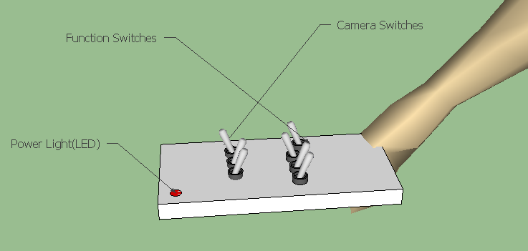
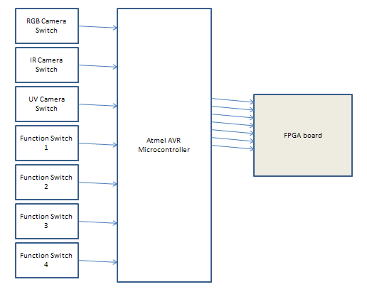
User Interface overview
User Interface Remote Control
Three Camera Switches
Four Function Switches
Power Light (LED)
Microcontroller/ FPGA Interface
Directly Connected Signals
Simple 7 High/Low Signals
Plenty of Open Pins on FPGA

Slide 28
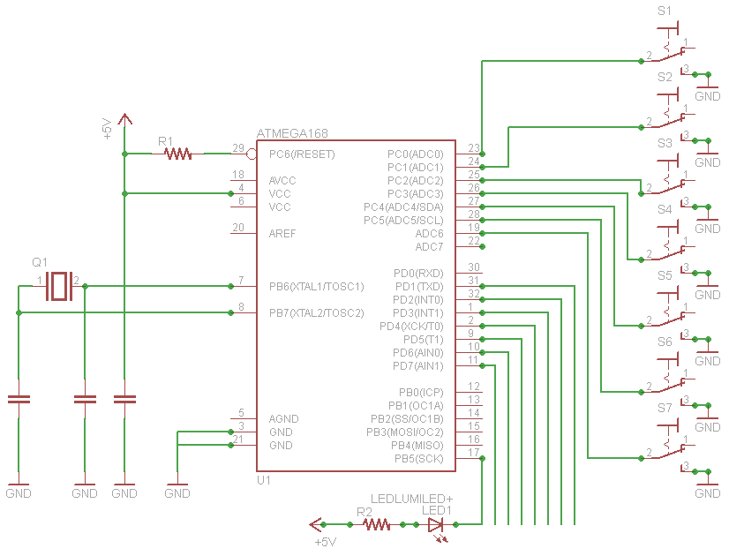
User Interface Hardware Design
ATmega168 Microcontroller

Slide 29
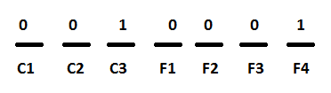
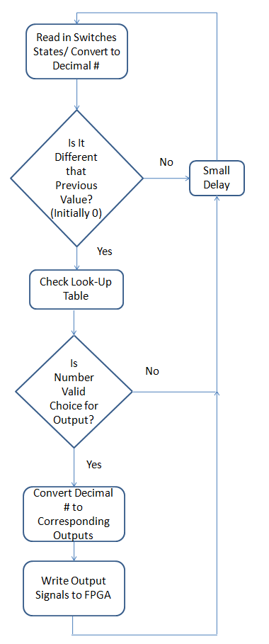
User Interface Software Design
Look-UP-Table
Array of 128 possible choices
Valid choice =1, Invalid choice = 0
Reason for Design
Goal is to allow for any possible combination
of Cameras and Functions
Current design allows for easy modification
of any choice to be allowed or not

Slide 30
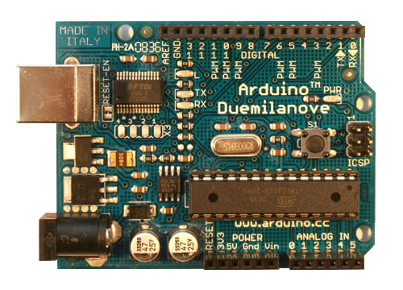
User Interface Development Tools
Arduino Duemilanove board
Easy Java-like Wiring language
Free Open Source Software
USB Programmable
Free, We already had one!

Slide 31
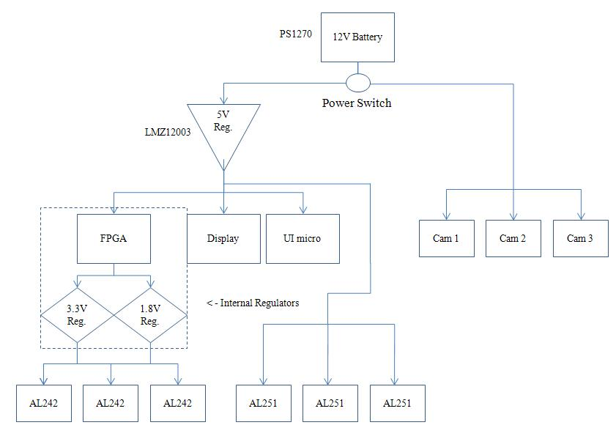
Power Supply Overview

Slide 32
Power Specs and Reqs
The unit shall have a portable power supply, such as a type of battery.
The unit shall provide power outputs of 12 Volts and 5 Volts.
The power source shall be safely placed in the backpack, and any power lines that are run outside will be covered safely.
The power source shall have storage capacity capable of running the system for 2 hours.
The power supply shall have an On/Off switch to shut the system off.

Slide 33
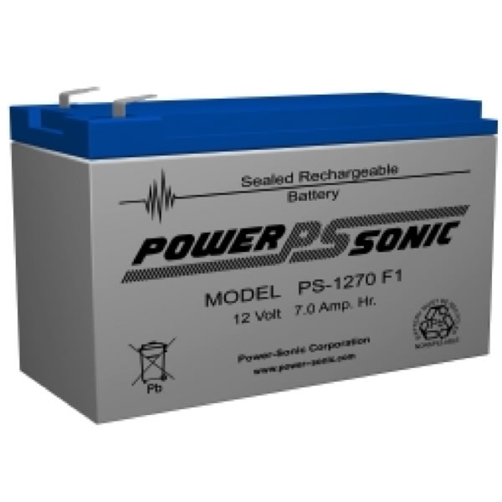
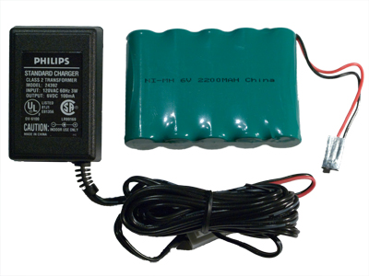
Battery
Original battery chosen: 12 Volt, 7 Amp hour, Lead Acid
Could be replaced with a new battery for final system; new cameras only require 5V input.
New battery will likely be 6 Volt, 2.2 Amp hour, NiMH; this will cause a shorter use-time, but it is lighter and cleaner.

Slide 34
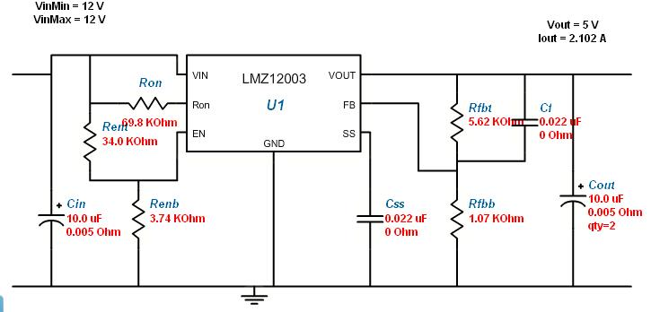
LMZ12003 Regulator Design
[
Regulator for original design.
Input 12V : Output ~5 V, as shown.
Capable of up to 3A output load, which covers our entire system, if necessary.
Automatic shutdown when 1.18 V is reached.

Slide 35
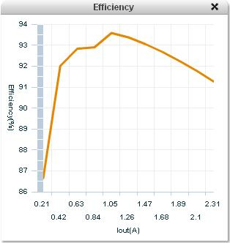
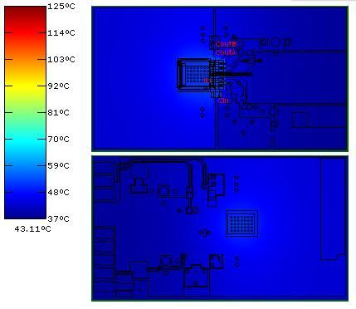
Efficiency and Thermal Considerations
Over 90% efficient from 0.3 A to roughly 2.5A output.
Likely no thermal issues at the regulator.
If using new power source, another regulator with comparable or better specs has been found.

Slide 36
Physical Specs and Reqs
The unit shall have a weight of no more than 50 lbs.
No more than 10 lbs. can be attached to the user’s head; the remaining weight shall be distributed elsewhere.
Any electrical components attached to the helmet shall be covered for safety.
Components in the system will be secured properly with screws and within the backpack to prevent problems during movement.

Slide 37
Physical Specs and Reqs
The unit shall have a weight of no more than 50 lbs.
No more than 10 lbs. can be attached to the user’s head; the remaining weight shall be distributed elsewhere.
Any electrical components attached to the helmet shall be covered for safety.
Components in the system will be secured properly with screws and within the backpack to prevent problems during movement.

Slide 38
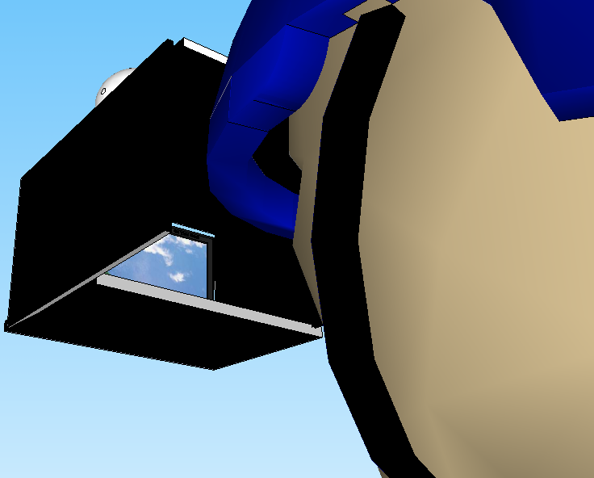
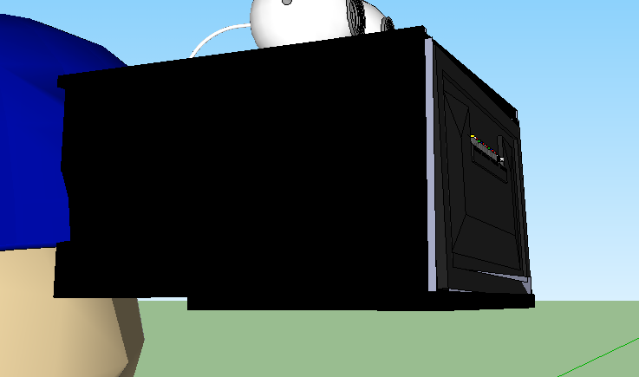
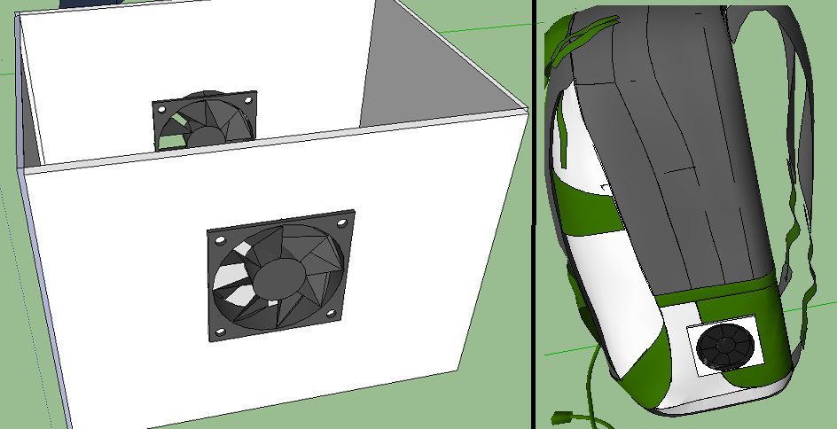
Physical Distribution Overview

Slide 39
Current Project budget/ Estimated Final budget
C3188A Camera - $56.95 x3 = $170.88
UV and IR lenses - $60.00
Nexsys2 FPGA - $100.00
PSOne Display Screen - $60.00
12 V7 AH PS1270 Battery - $19.00
Power Supply 5V Regulator - $5.00
Arduino Duemilanove - $30.00
Backpack and Bicycle Helmet - $40.00
Testing supplies - $100.00
Total: $584.88

Slide 40
Current project progress (as of CDR presentation)

Slide 41
Immediate plans for completion
Resolve camera issue; configure new camera for digital output while testing filtering via composite output.
Continue building FPGA code for video processor.
Continue UI microcontroller programming and setup, order PCB.
Reconfigure power supply design for new camera, if cost and time permit; otherwise, build as currently designed.

Slide 42
Questions?

